Slide 1
Notes:
Lukas doing short introduction, thanks to all for attending and hope they find the presentation informative.

Slide 2
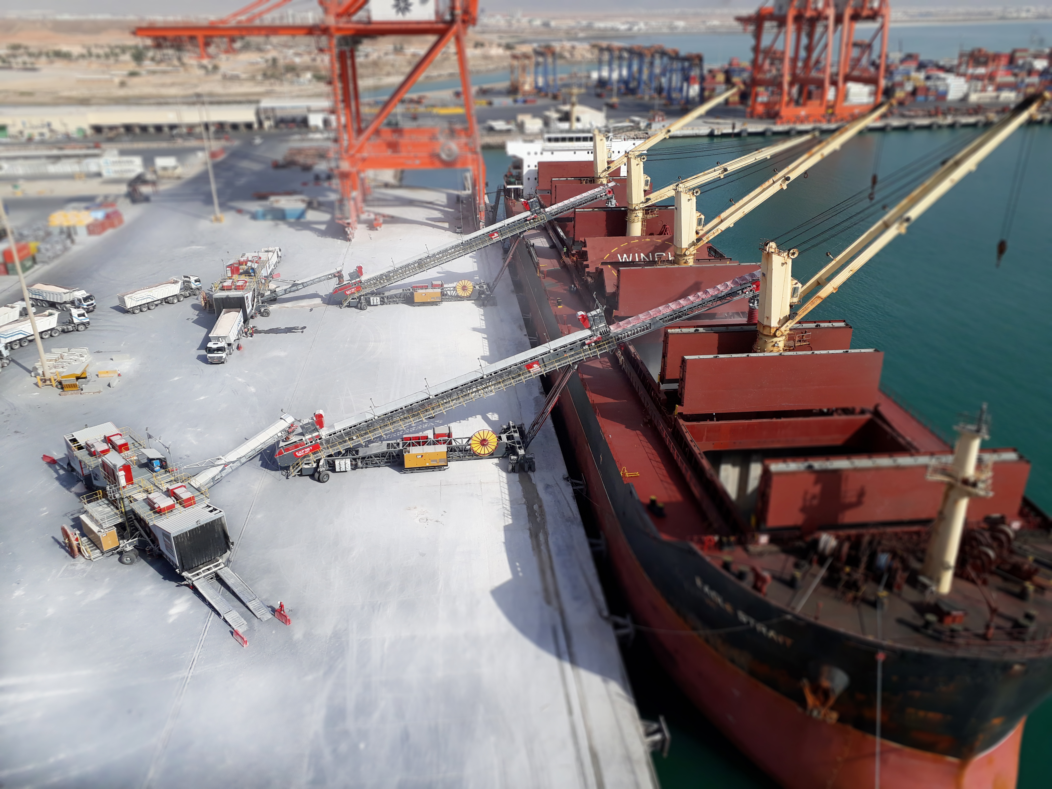
Presentation Agenda:
Changing Trends and Uncertainities
Moving to Mobile
Environmental Concerns
‘Pit to Port to Plant’
Case Studies
Conclusions and Questions
Notes:
Overview of Presentation Agenda

Slide 3
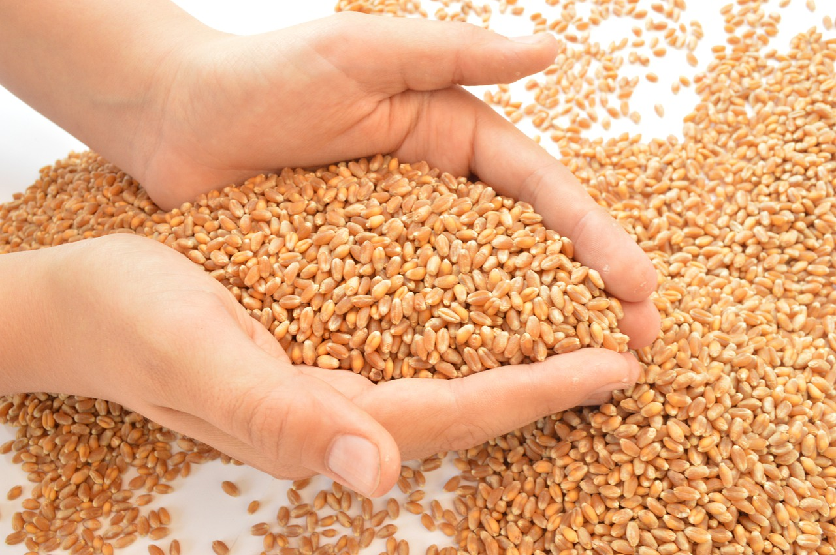
Changing Trends and Uncertainities
How to deal with these uncertainities in Dry Bulk Production / Shipping and Supply / Demand?
How to react to these changes? - Agility and Flexibility
Reduce Costs per tonne – Port Operators / Stevedores
Minimise Risk – Mobile Assets

Slide 4
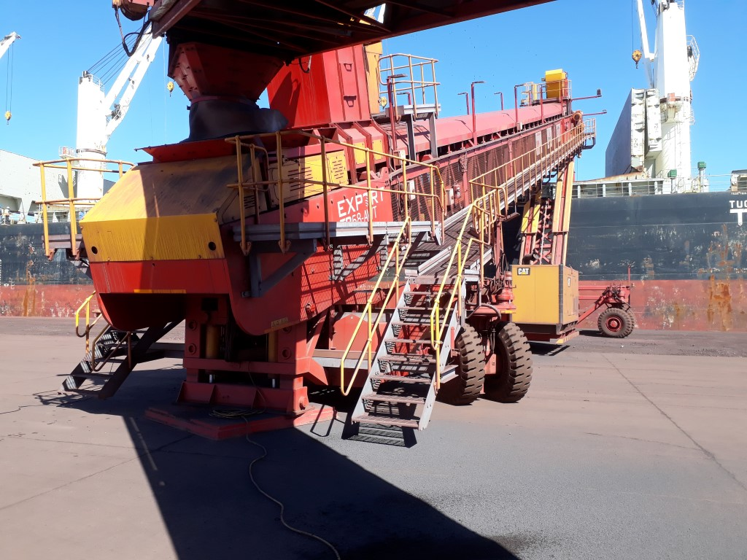
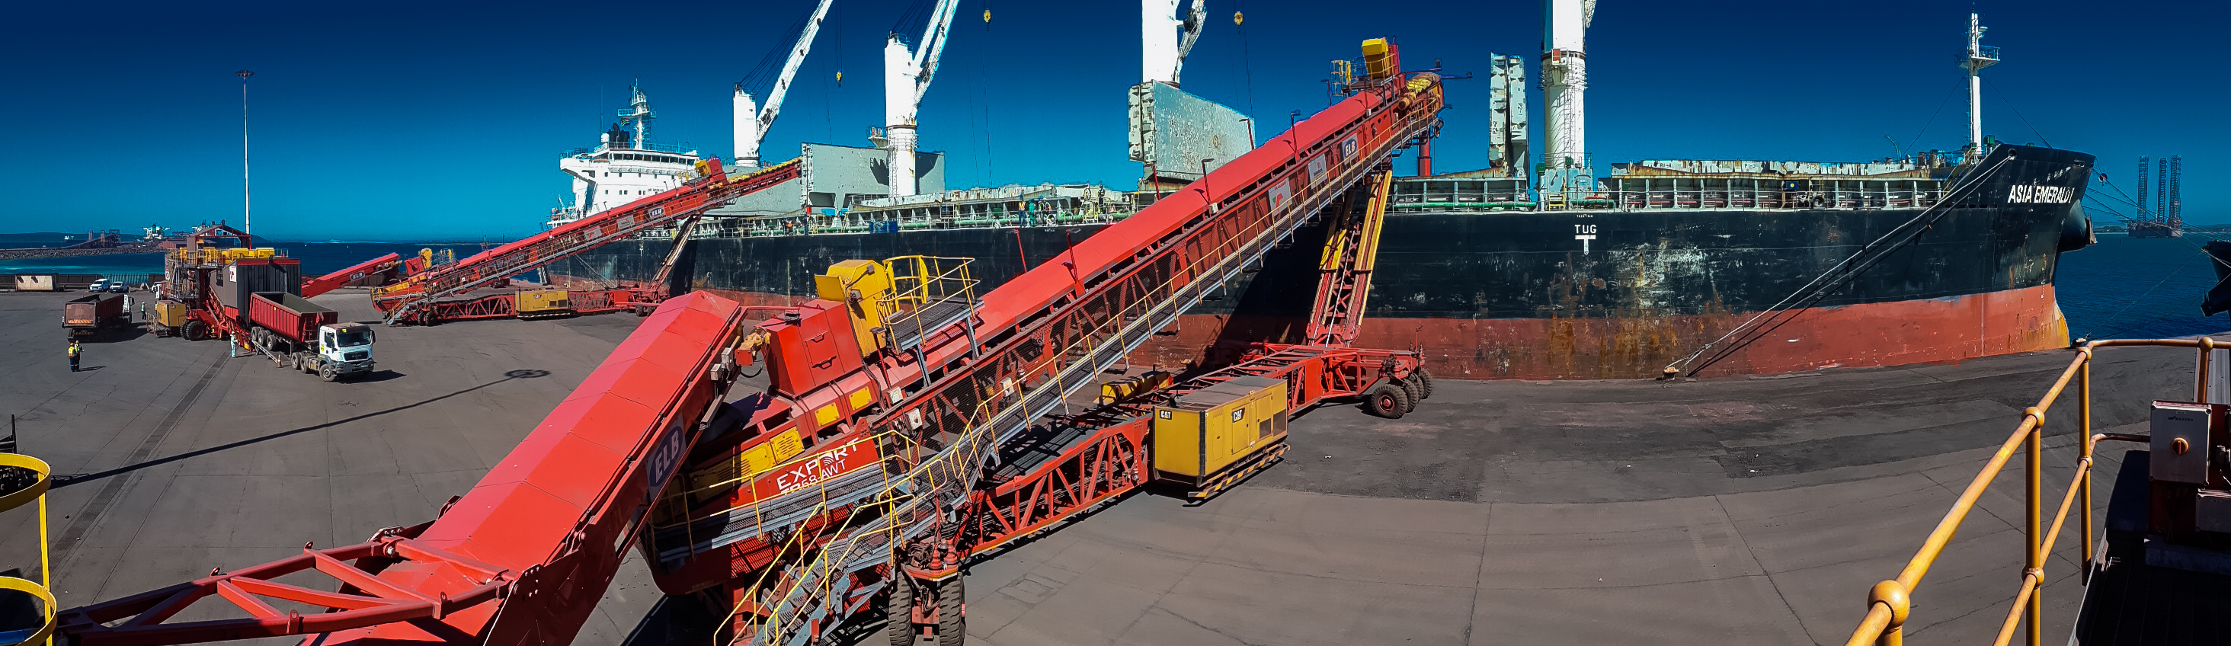
Moving to Mobile
Complimentary to traditional Dry Bulk handling methods (Fixed Conveyors / Harbour Cranes)
Innovative Solutions to increase flexibility – Rapid Deployment
Alternative Handling methods with dedicated Mobile Dry Bulk system – Opportunity Cost
Multi-cargo Berths – Dedicated Berths / Stockyard Management systems

Slide 5
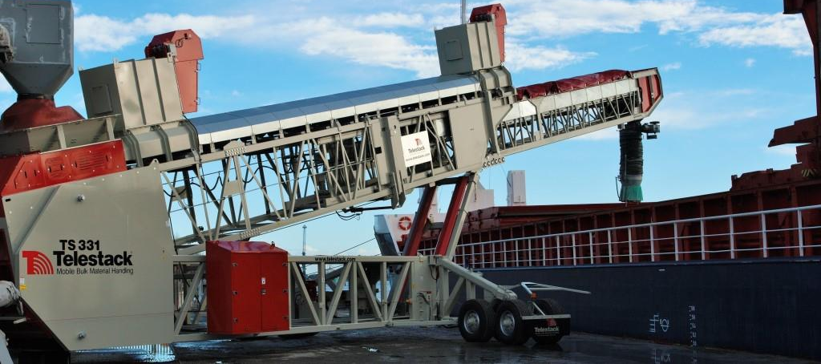
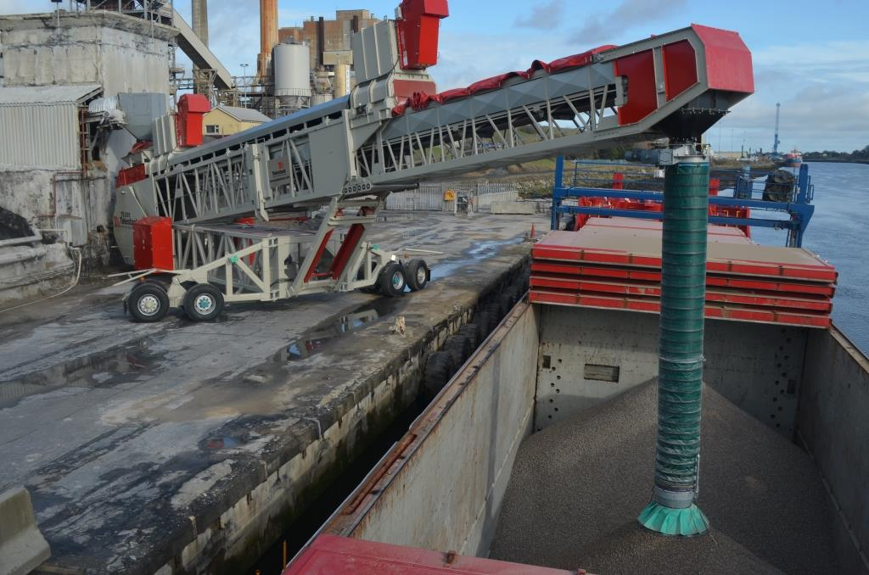
Environmental Concerns
Concerns on suitability of Mobile Solutions ability to handle difficult dry bulk materials
Integration of proven Extraction / Containment measures (E.g Dust Extraction filters / Double sealing)
Improvement of handling method to meet Local, National and Corporate Environmental standards – ESG Strategy – Future Proof Systems

Slide 6
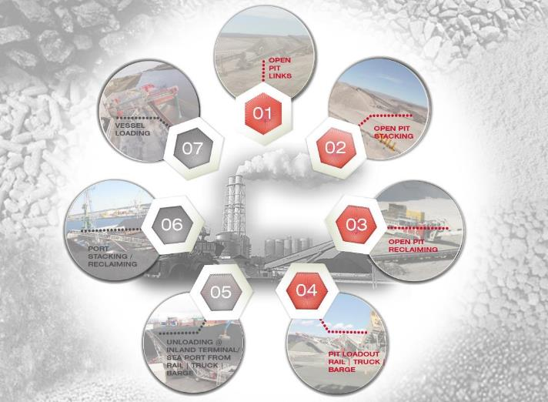
Where can you add
efficiencies to your Logistic’s Chain?

Slide 7
Case Studies

Slide 8
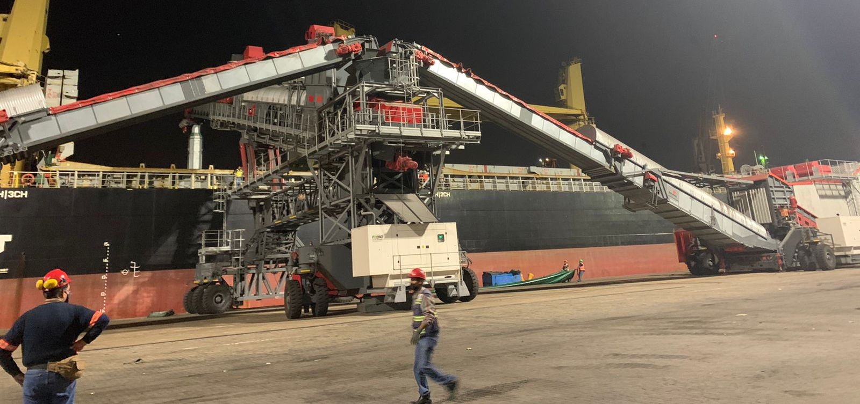
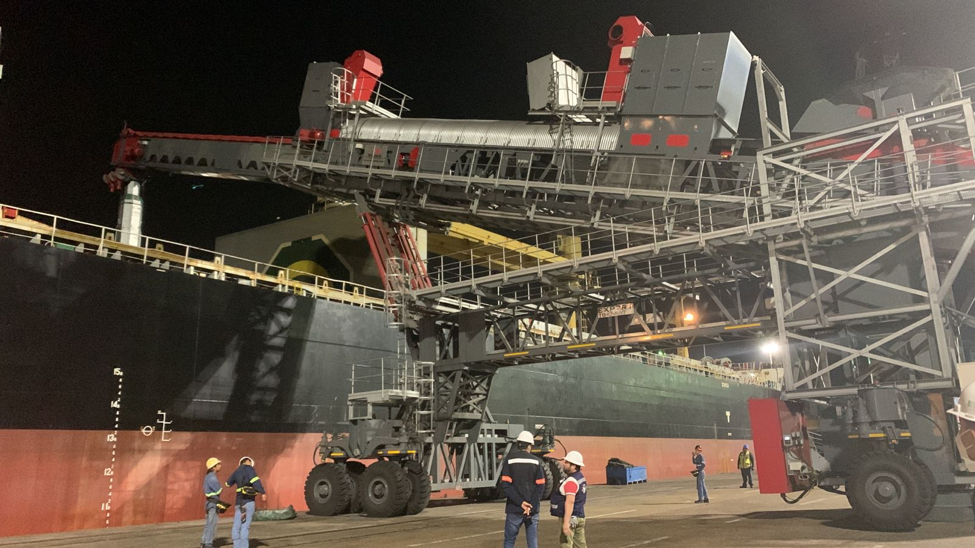
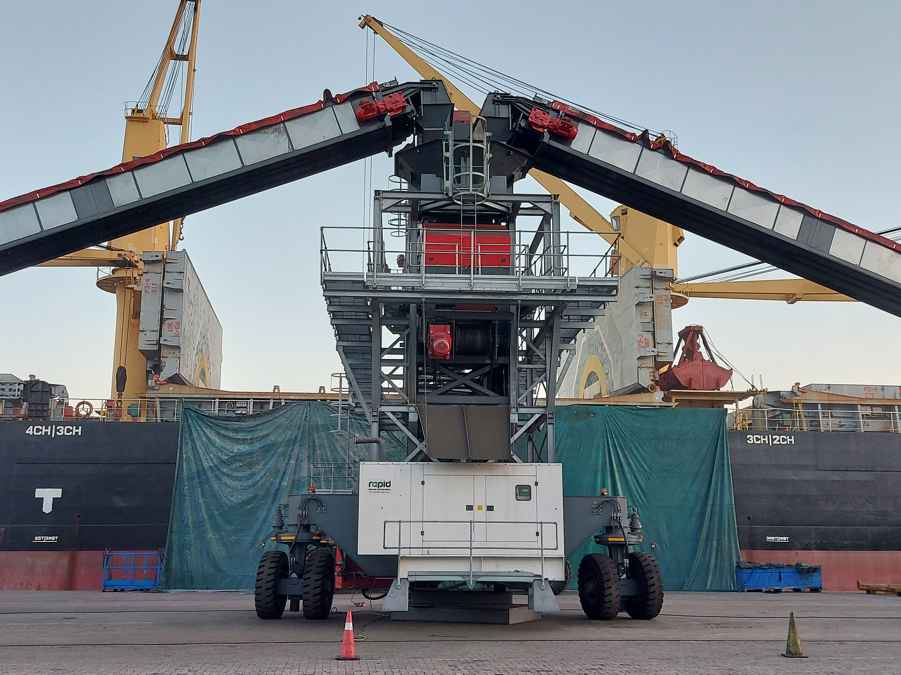
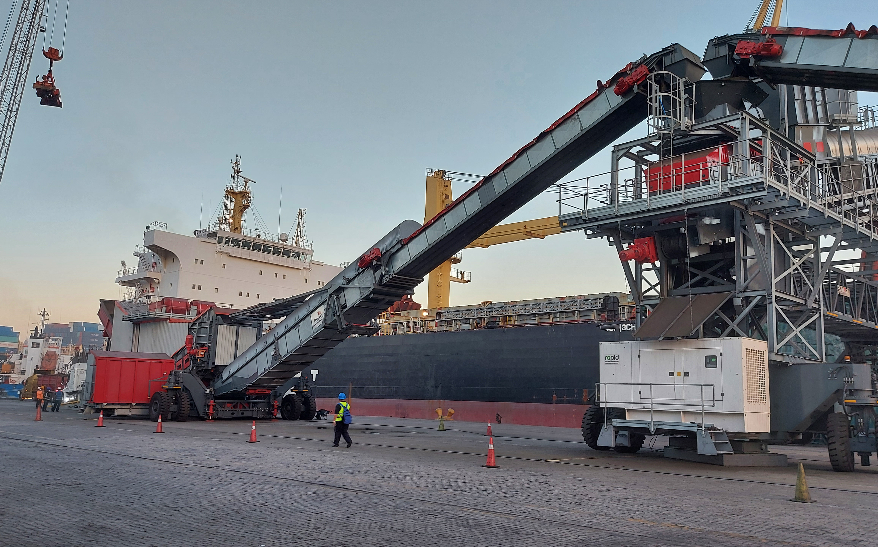
Impala Terminals
Mexico
System – 2 x Titan Truck Unloaders and 1 x High Rise Shiploader
Application – Truck to Vessel Copper Concentrate @ 1000TPH
Features – Dust extraction Filters, Sealed transfer points and High Rise Mobile Design

Slide 9
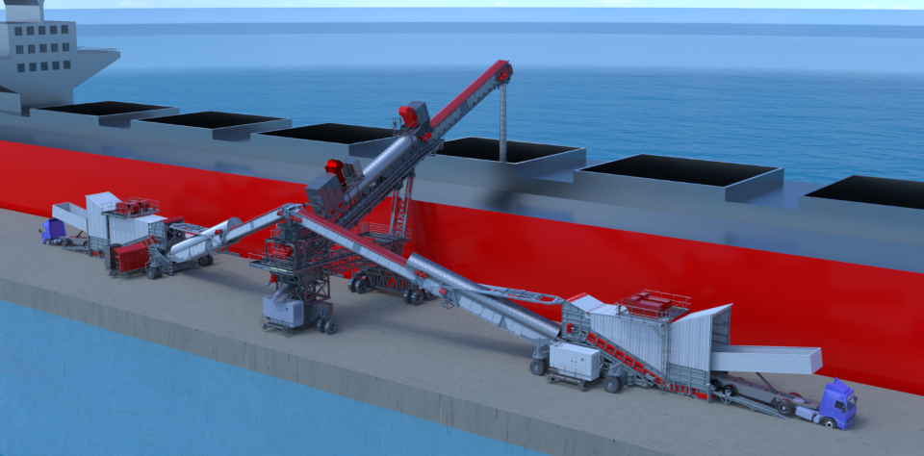
12m (39ft) Free-Board Height
Narrow Berth – 25m (82ft) Panamax Vessels

Slide 10
Cementos Tudela
Spain
System – 2 x Titan S800-6 Static Bulk Reception Feeders and Links / Shiploader
Application – Truck to Plant – Shiploading system – Cement Clinker
Features – Dust extraction Filters and Integration with Plant

Slide 11
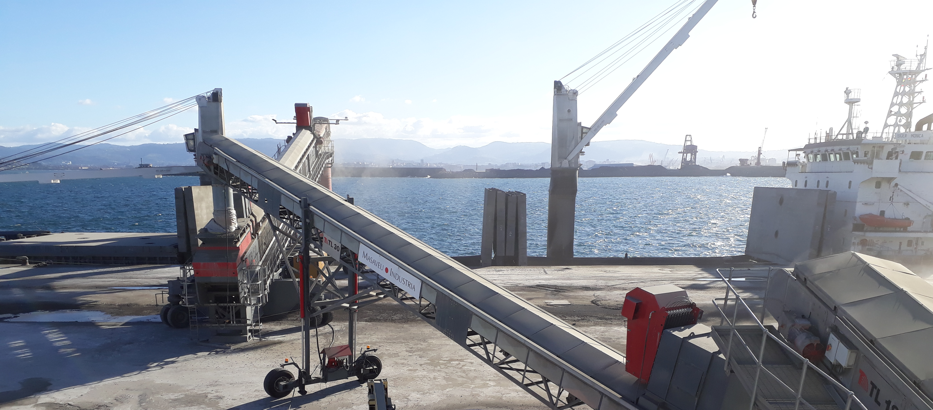
Cementos Tudela
Spain
System – 2 x Titan S800-6 Static Bulk Reception Feeder and Links / Shiploader
Application – Truck to Vessel (Cement Clinker @ 1000TPH)
Features – Dust extraction Filters, Sealed transfer points and mobile shiploading system to Coaster / Handymax Vessels

Slide 12
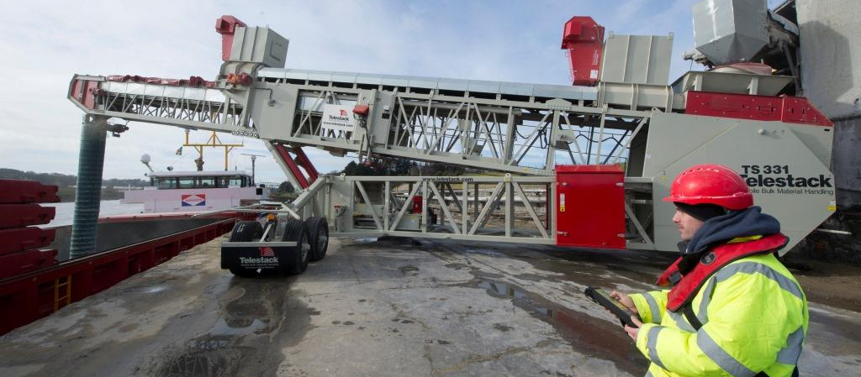
PREMIER PERICLASE – IRELAND
System – TS 331 Radial Telescopic Shiploader loading Coaster Vessels
Application – Shiploading sintered magnesia @ 300tph from static conveyor

Slide 13
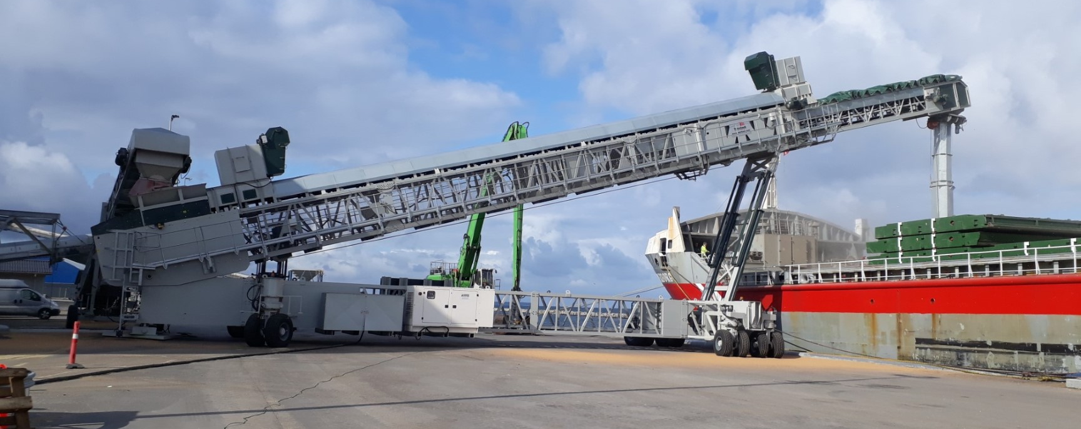
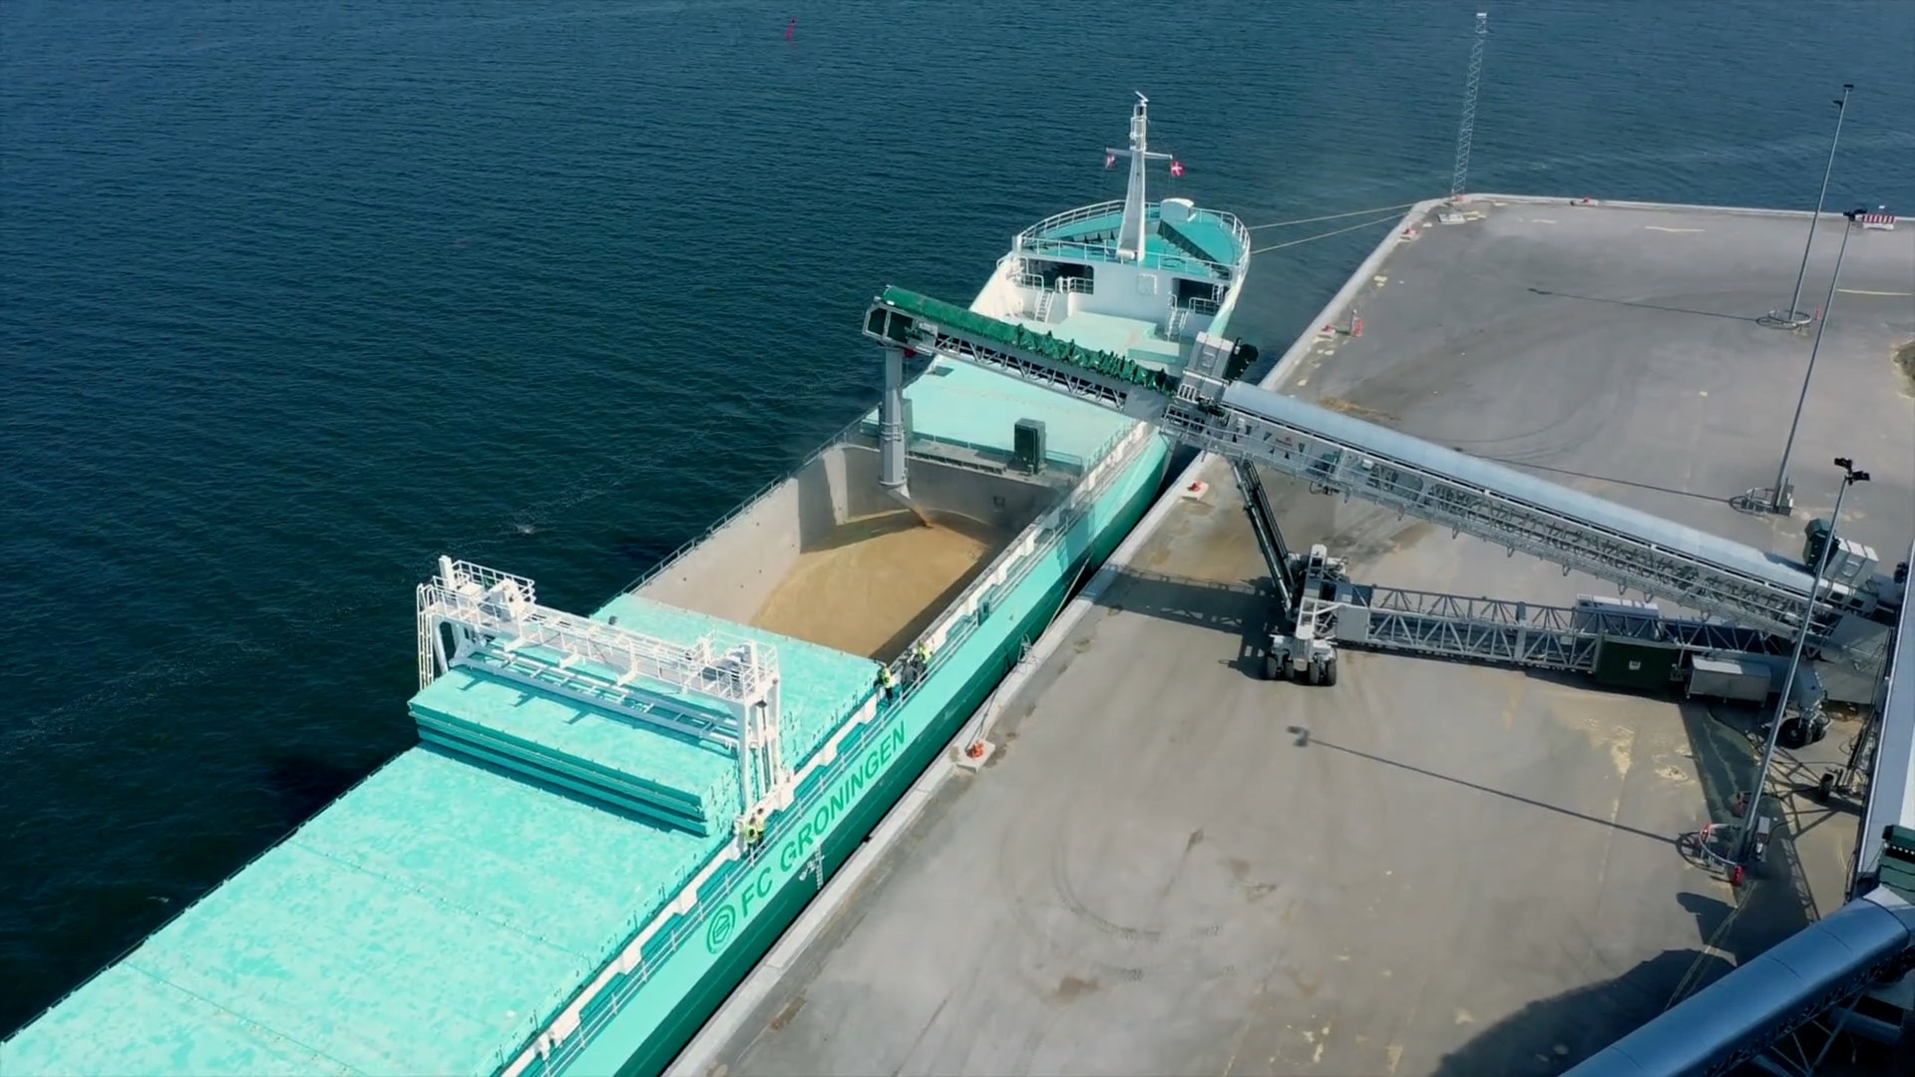
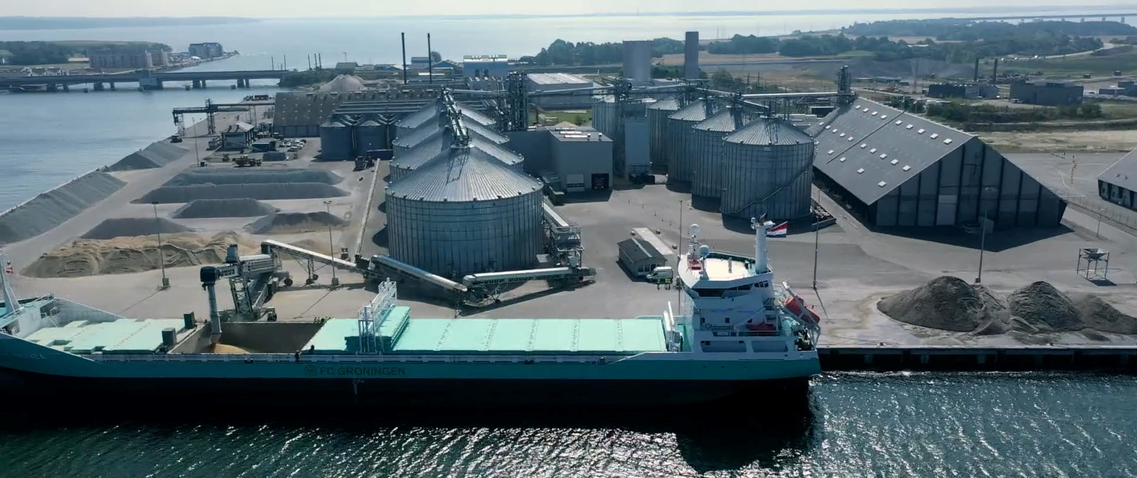
MASNEDO BULK TERMINAL
DENMARK
System –TB 52 All Wheel Travel Shiploader & TL Link Conveyors
Application – Shiploading grains from Silo’s and Flat Storage

Slide 14
OXXEAN
CHILE
System –TB 58 Radial Telescopic Shiploader
Application – Shiploading Woodchips To panamax vessels from overland conveyor system

Slide 15
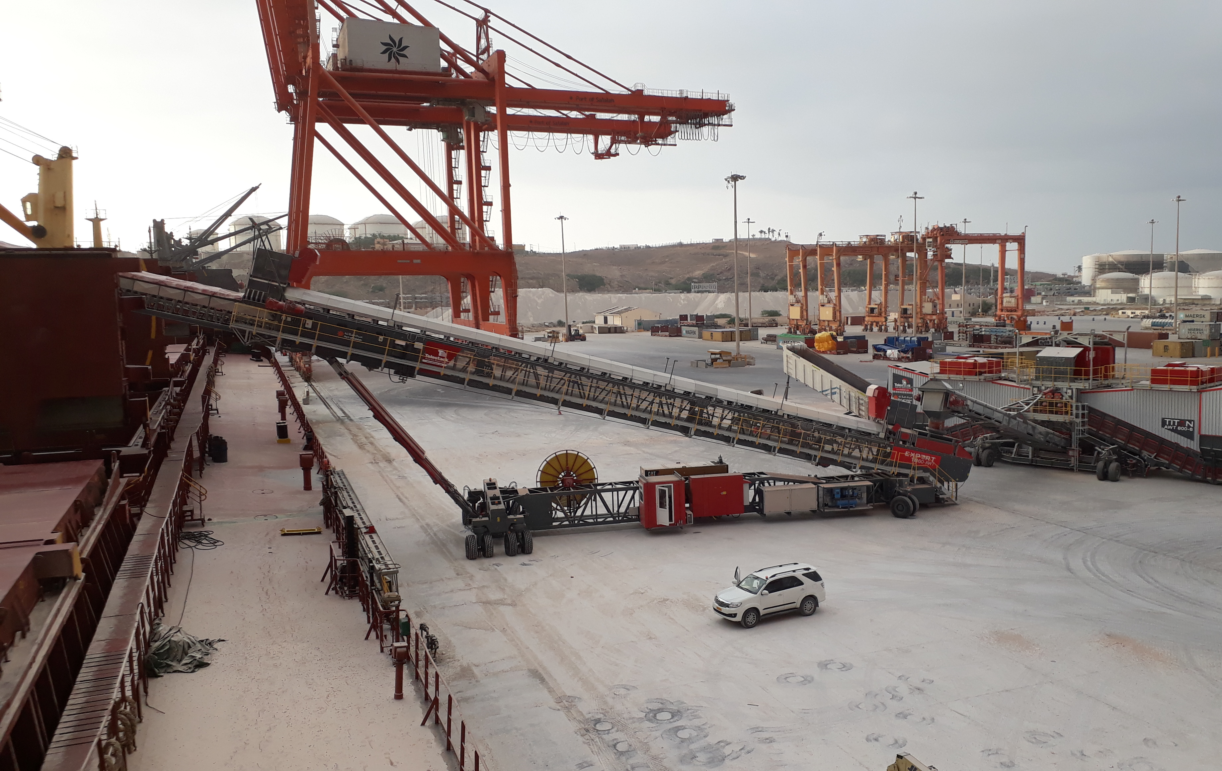
Port of Salalah, Oman
System – 2x TB 58 Export All Wheel Travel Shiploader & Titan AWT800-6 All Wheel Travel Bulk Reception Feeder
Application – Shiploading to Handymax Vessels – Truck to Ship – Gypsum and Clinker

Slide 16
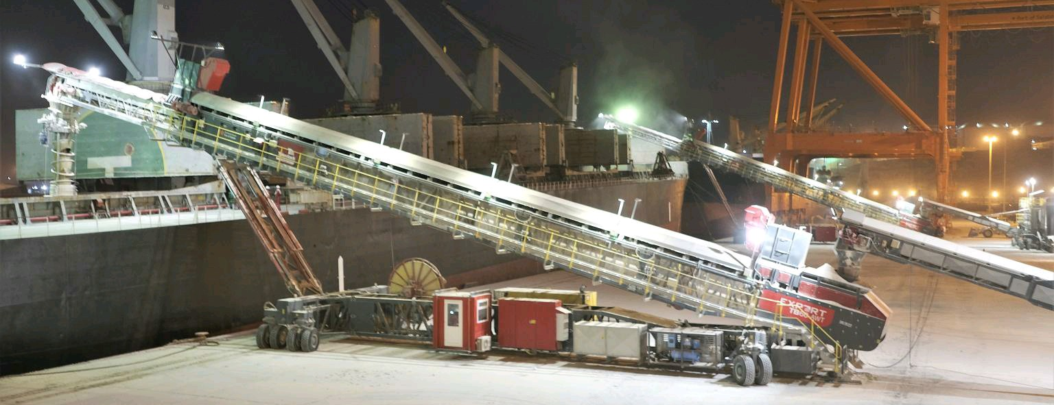
Port of Salalah, Oman
System – 2 x TB 58 Export All Wheel Travel Shiploader & Titan AWT800-6 All Wheel Travel Bulk Reception Feeder
Application – Shiploading to Handymax Vessels – Truck to Ship – Gypsum

Slide 17
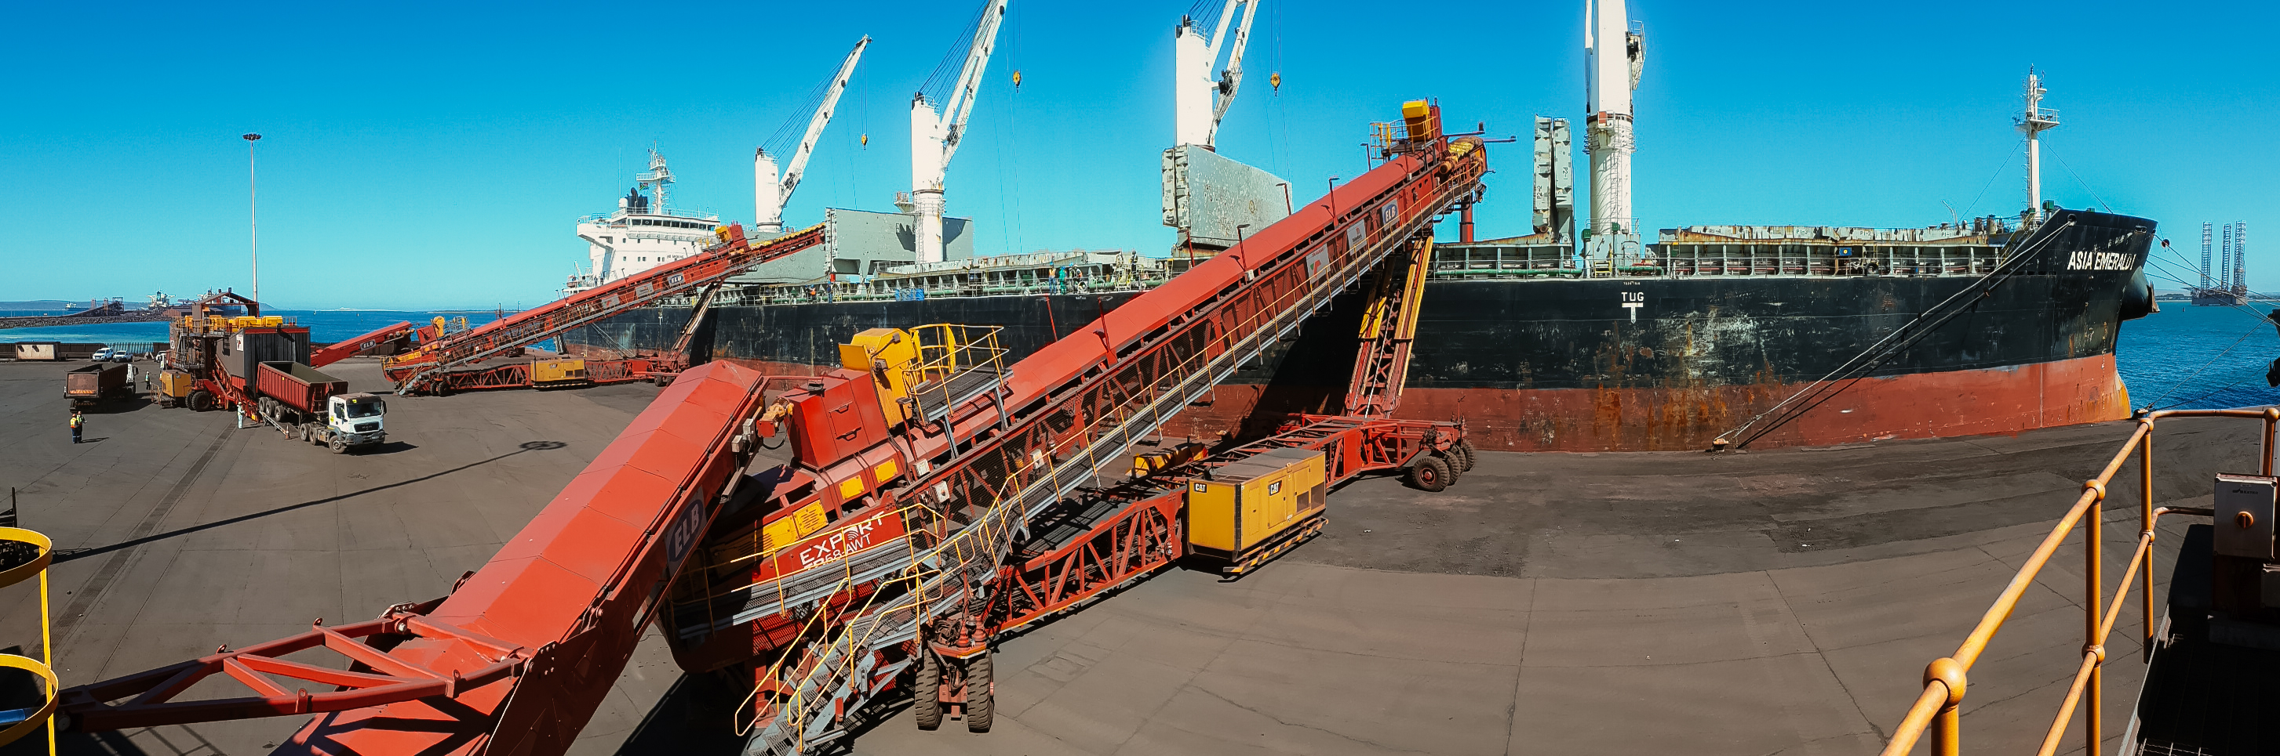
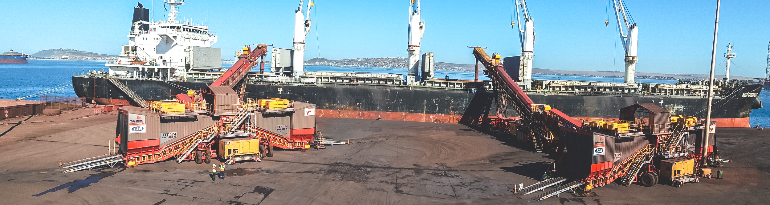
TRANSNET
SOUTH AFRICA
System – 2 x TB 58 Export All Wheel Travel Shiploader & Titan AWT800-6 All Wheel Travel Bulk Reception Feeder
Application – Shiploading Manganese Ore to Panamax Vessels – Truck to Ship

Slide 18
WATCO Terminals
USA
System – 2 x TB 52 Export All Wheel Travel Shiploader
Application – Shiploading & Unloading vessels from Mobile Unloading Hopper

Slide 19
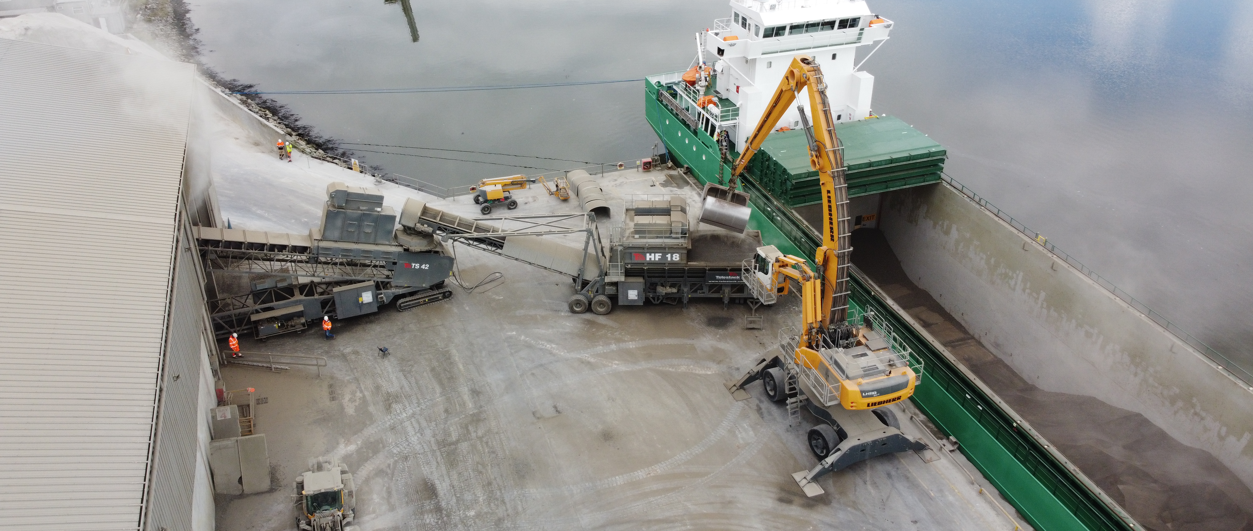
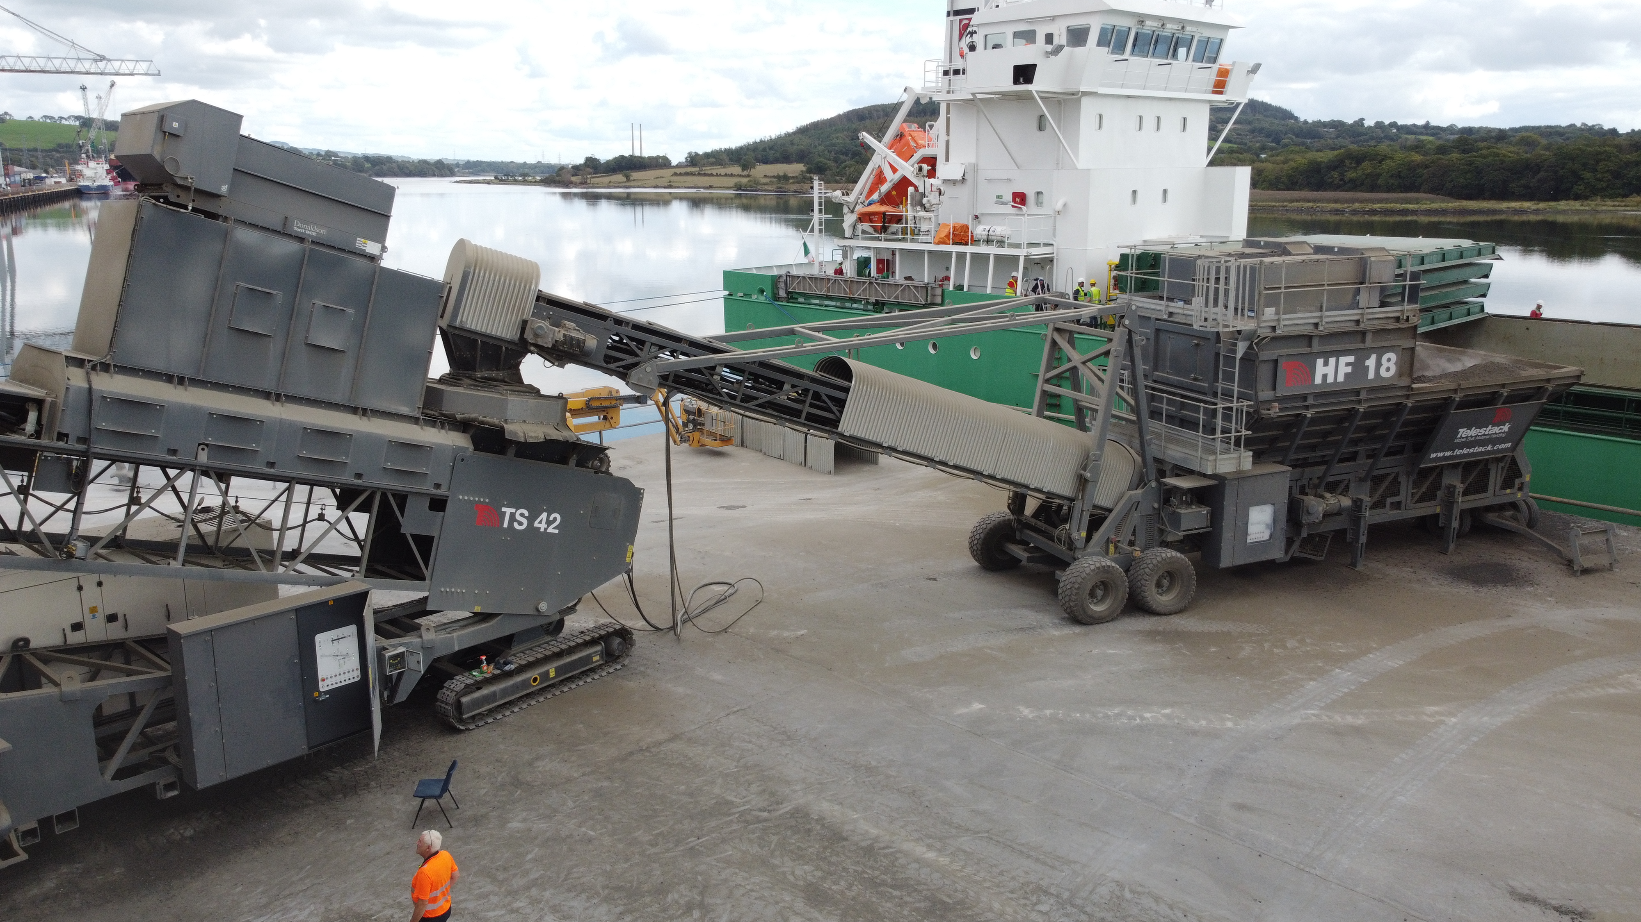
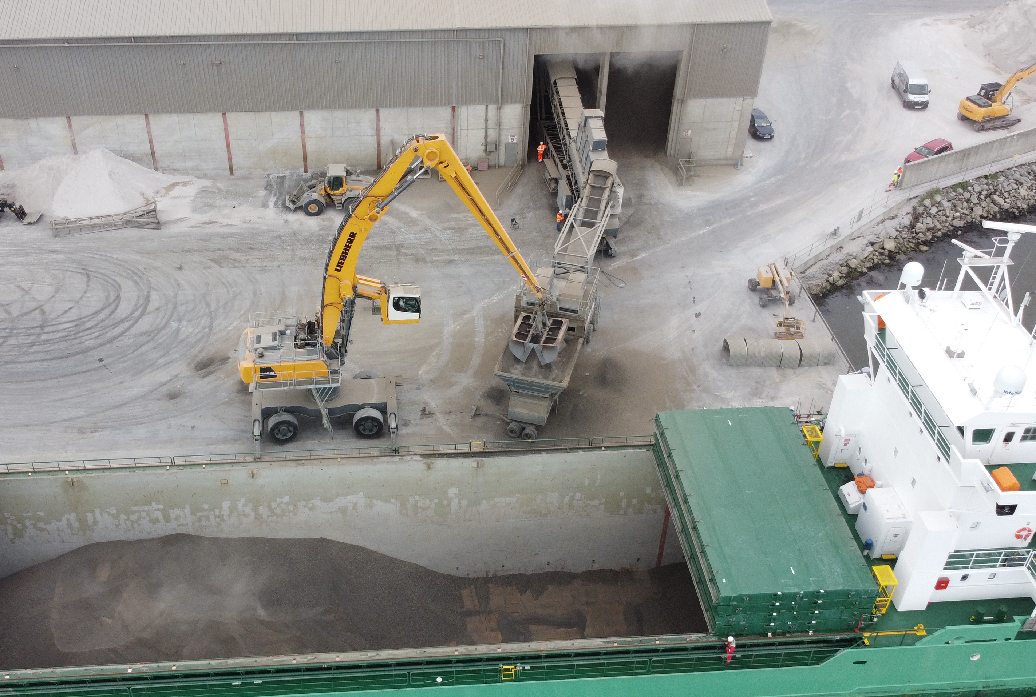
O’Briens Cement, Ireland
System – HF 18 Hopper feeder fed from Grab feeding TS 42 Ship-Unloader
Application – Ship Unloading Cement clinker @ 600TPH from Grab directly from Vessel to Warehouse

Slide 20
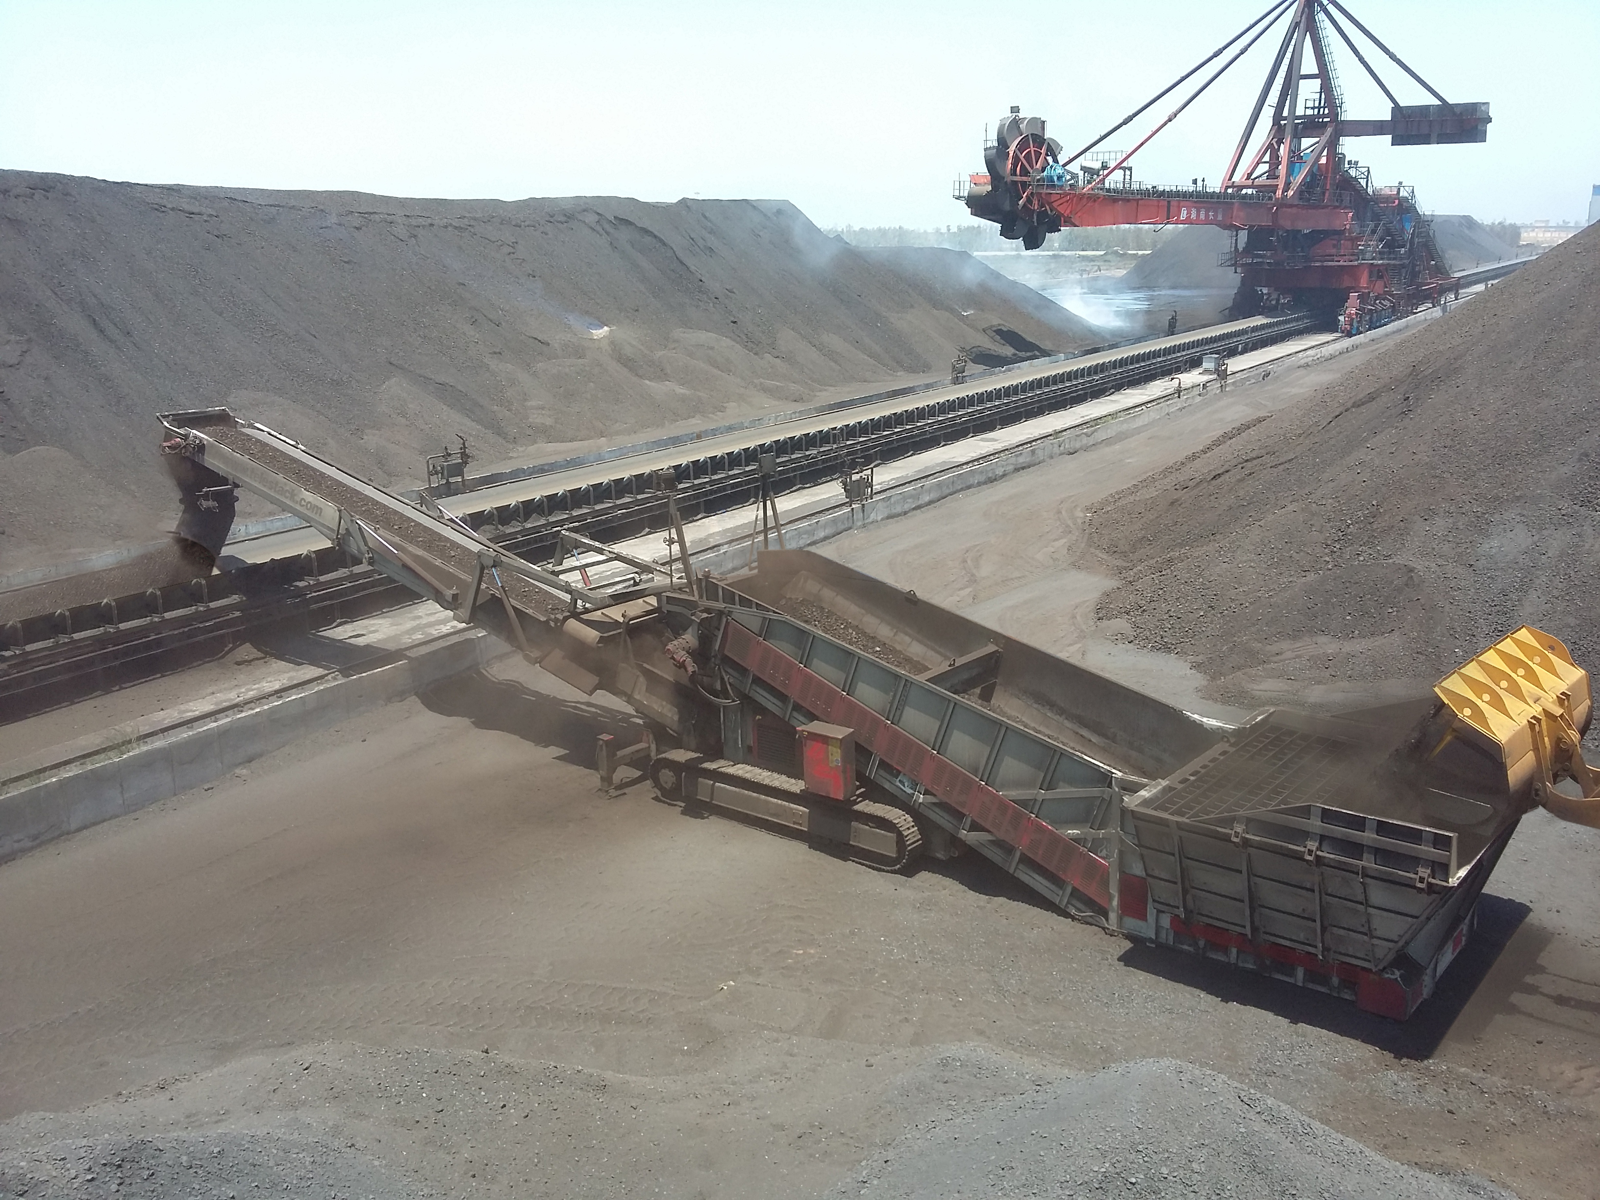
COAL POWERPLANT
INDIA
System – Titan Reclaiming Hopper to Stacker / Reclaimer / Coal Blending
Application – Reclaiming coal @ 500 tph
Features – Dual Power
200mm grid
Overband Magnet
Discharge Chute
Directional Chute
Lights

Slide 21
Conclusions
The need to Future Proof your Dry Bulk Operation to deal with uncertainties
Enhance your Opportunities – Improve Existing Operations and develop NEW Business
Moving to Mobile – Build Flexibility into your Dry Bulk Handling
Your Dry Bulk Logistics Chain – Have you reviewed where to improve your process?
Maximising the Existing Infrastructure available – Rapid Deployment ( 6 – 9 months)
Agility and Flexibility in all Areas of the Dry Bulk Operation

Slide 22
Thank You
Questions?

